Slide 1

CUSTOMER CHURN PREDICTION
DATA MINING FINAL PROJECT

Slide 2


OUTLINE
INTRODUCTION
Data Mining Definition
Dataset and Business Problem
DATA CLEANUP
Checking null values and imbalance in the data.
Checking and fixing data types
Removing unnecessary columns and negative values
Detecting and removing Anomalies or Outliers
DATA DISCOVERY : Exploratory data analysis
Histograms
Box Plots
Distribution plots
Correlation plots
DATA MODELLING
Model : Classification
DATA OPTIMIZATION : Predictive Modelling
Feature Selection : Forward and Backward Method
Feature Engineering: One hot Encoding
Complex Algorithms: Various Classification model
Metrics: Confusion Matrix, Model.Score and Training time
DATA STORYTELLING
Data Visualization using Dashboard

Slide 3

DATA MINING DEFINITION
PROCESS LARGE RAW DATASETS INTO USEFUL INFORMATION
CHECK FOR PATTERNS IN DATA
DERIVE MARKETING AND BUSINESS STRATERGIES
INSIGHTS TO INCREASE SALES AND PLAN COSTS EFFECTIVELY
DECREASE COSTS

Slide 4

DATASET DESCRIPTION
DATASET : CUSTOMER CHURN PREDICTION
ATTRIBUTES:
GENDER
SENIORCITIZEN
PARTNER
DEPENDENTS
TENURE
PHONE SERVICE
MULTIPLE LINES
INTERNET SERVICE
ONLINE SECURITY
ONLINE BACKUP
TECH SUPPORT
TARGET VARIABLE: CHURN ( WHEATHER CUSTOMER STAYED OR CHURNED )

Slide 5
BUSINESS PROBLEM
TO IDENTIFY AND TARGET CUSTOMERS WHO HAVE HIGHER POTENTIAL KEEPING THE SUBSCRIPTION
DEPT. 4

Slide 6
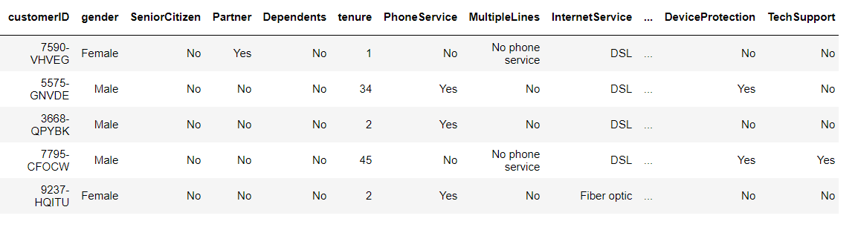
DATA CLEANING
IMPORTING THE DATASET AND NECESSARY LIBRARIES:
DEPT. 4

Slide 7
DATA CLEANING
REMOVED THE NULL VALUES OF THE DATASET
FIXED THE DUPLICATE VALUES
SEPERATED CATEGORICAL AND CONTINUOUS VALUES
FIXED THE DATA TYPES OF THE VARIABLES IN THE DATASET
THERE WERE NO OUTLIERS PRESENT IN THE DATASET. GENERALLY IF OUTLIERS ARE PRESENT WE CAN REPLACE IT WITH CAPPING METHODS
DEPT. 4

Slide 8
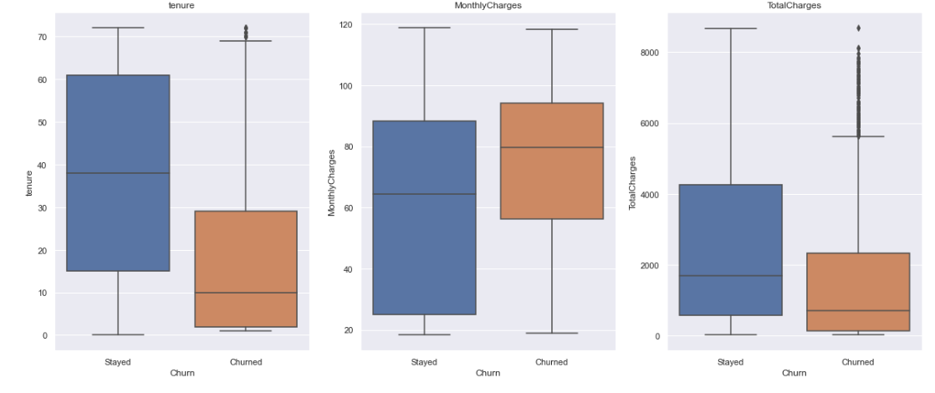
DATA CLEANING
OUTLIER DETECTION FOR CONTINOUS VARIABLES
DEPT. 4

Slide 9
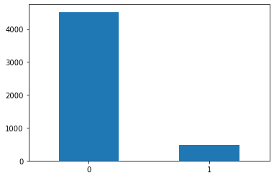
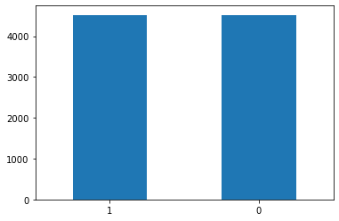
DATA CLEANING
CHECKING THE IMBALANCE IN THE DATASET
FIXING IT WITH RANDOM OVER SAMPLING METHOD
Before Sampling
After Over Sampling
DEPT. 4

Slide 10
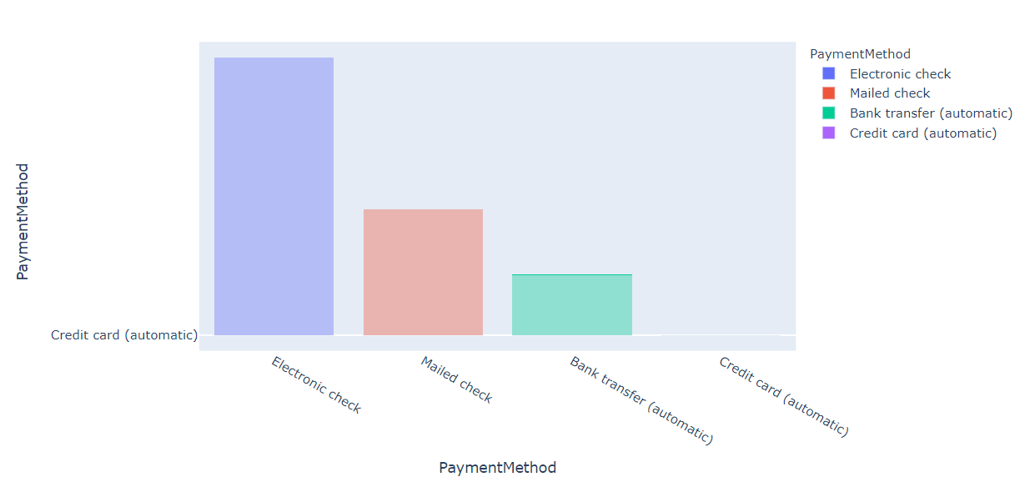
DATA DISCOVERY : EDA
COUNT PLOT FOR PAYMENT METHODS:
Count plot of various payment methods in the dataset. We can see that most of the customers prefer using electronic checks for payments.
DEPT. 4

Slide 11
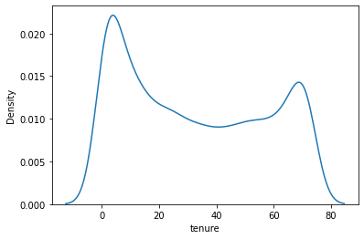
DATA DISCOVERY : EDA
DENSITY PLOT FOR TENURE:
From the above density plot we can see that the tenure mostly ranges from 10 to 70 values.
DEPT. 4

Slide 12
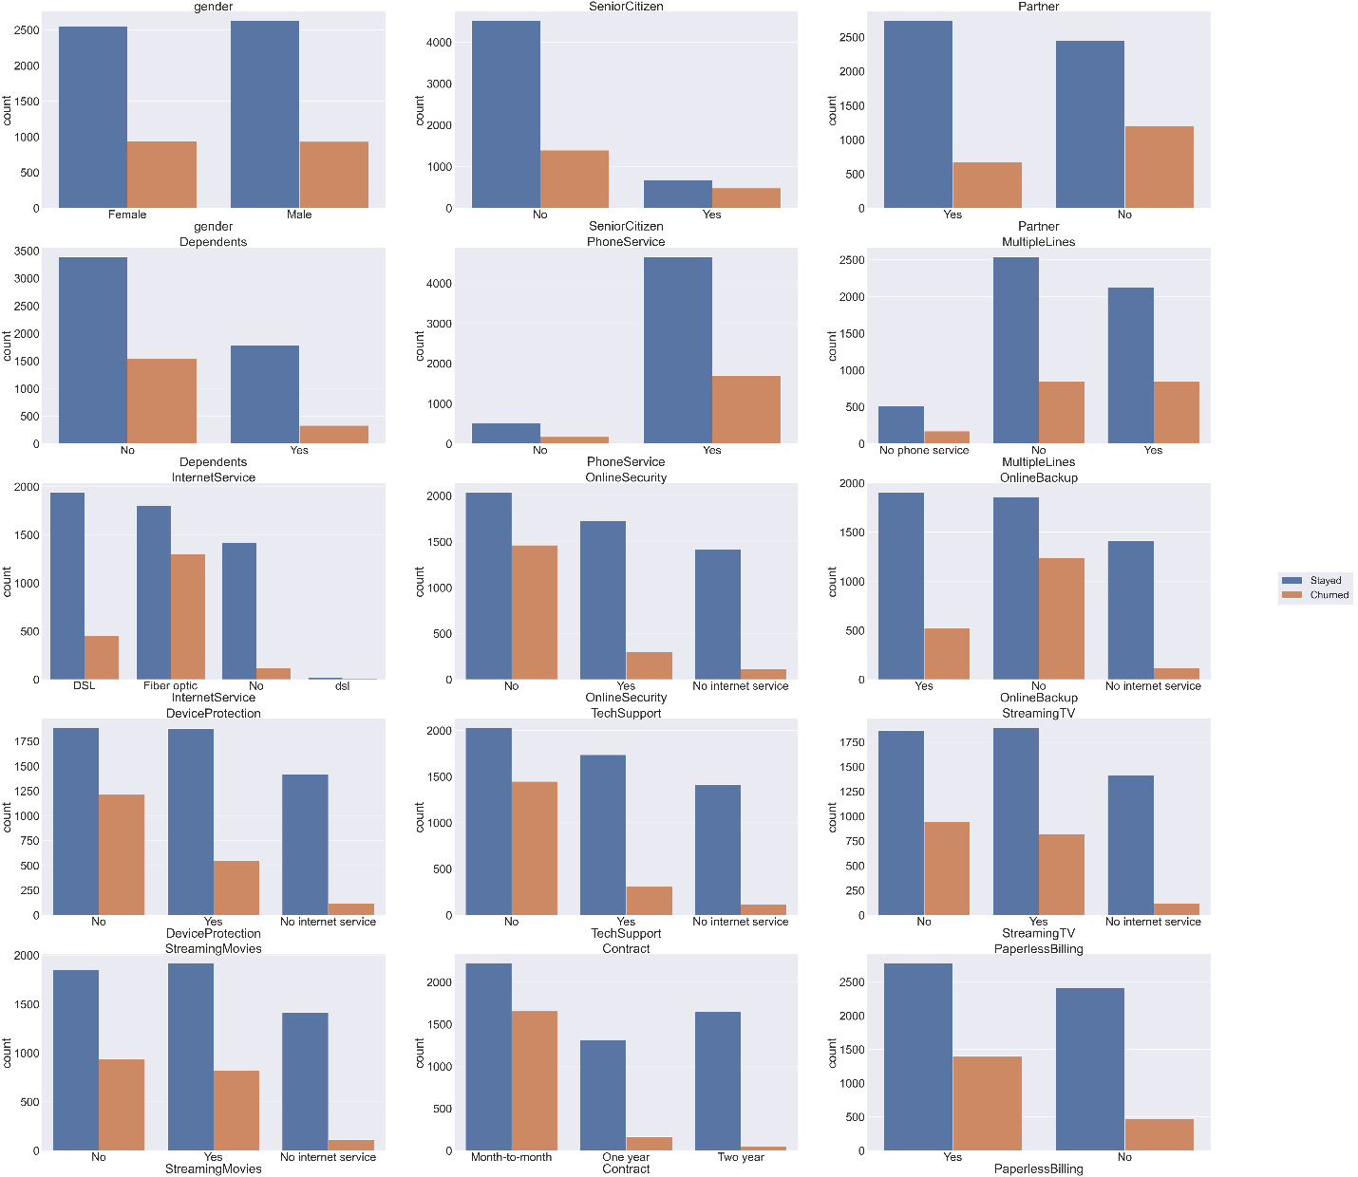
DATA DISCOVERY : EDA
UNDERSTANDING THE DISTRIBUTION OF NUMBERICAL VALUES IN COLUMNS MORTGAGE AND EDUCATION:
DEPT. 4

Slide 13
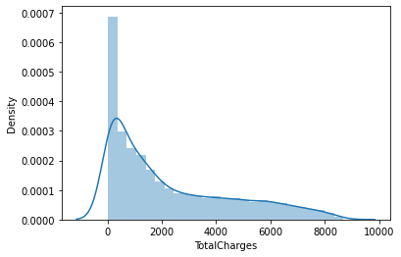
DATA DISCOVERY : EDA
DENSITY PLOT FOR TOTAL CHARGES
DEPT. 4
The density of most of the total charges range from 0 to 4500.

Slide 14
DATA MODELLING : TRAIN TEST SPLIT
IMPORTING NECESSARY LIBRARIES
STORING FEATURE VARIABLES IN X
STORING TARGET VARIABLE IN Y
SPLITTING THE DATA INTO 80% TRAIN 20% TEST
DEPT. 4

Slide 15
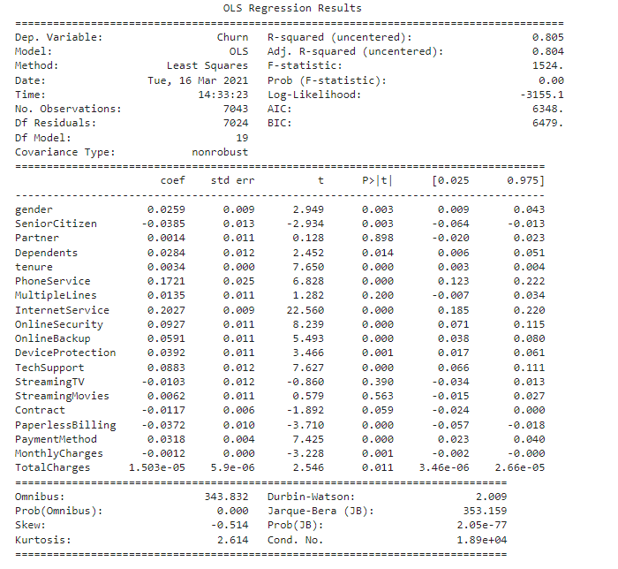
DATA MODELLING : LOGISTIC REGRESSION MODEL SUMMARY
DEPT. 4

Slide 16
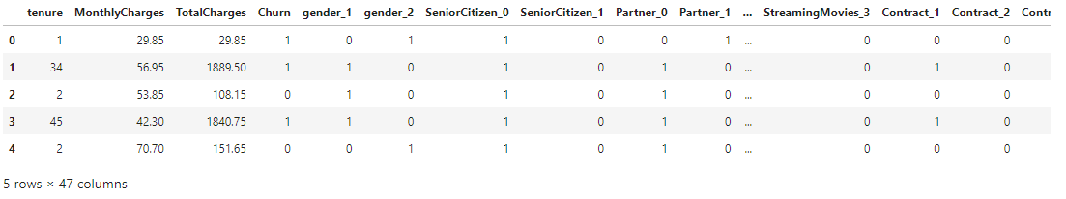
DATA OPTIMAZTION : FEATURE ENGINEERING
Generating new predictive features from existing features is an important aspect of machine learning.
DEPT. 4

Slide 17
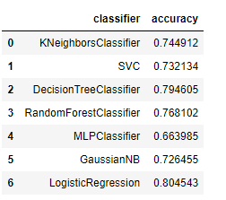
APPLYING MACHINE LEARNING CLASSIFICATION MODELS WITHOUT SCALING THE VARIBALES
The highest accuracy obtained was for Logistic regression which was 80%.
DEPT. 4

Slide 18
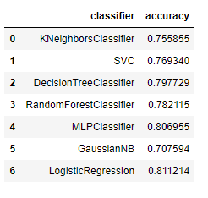
APPLYING VARIOUS MACHINE LEARNING MODELS AFTER SCALING THE DATASET
The results obtained were more accurate as compared to the results which were obtained without scaling the variables.
DEPT. 4

Slide 19
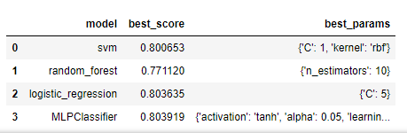
HYPERPARAMETER TUNING TO INCREASE MORE ACCURACY
The results obtained after tuning the model were not having a significant raise in the accuracy and almost all the models showed an accuracy of around 80%.
DEPT. 4

Slide 20
APPLYING ENSEMBLE LEARNING TO THE DATASET
Ensemble modelling is an interaction where various different base models are utilized to foresee a result. The reason for utilizing ensemble models is to lessen the speculation error of the prediction. The base models are different and free, the prediction error diminishes when the ensemble approach is utilized.
The results obtained for ensemble models were:
Decision Tree Classifier : 80%
Adaboost Classifier: 80%
Logistic Regression Classifier: 80%
DEPT. 4

Slide 21
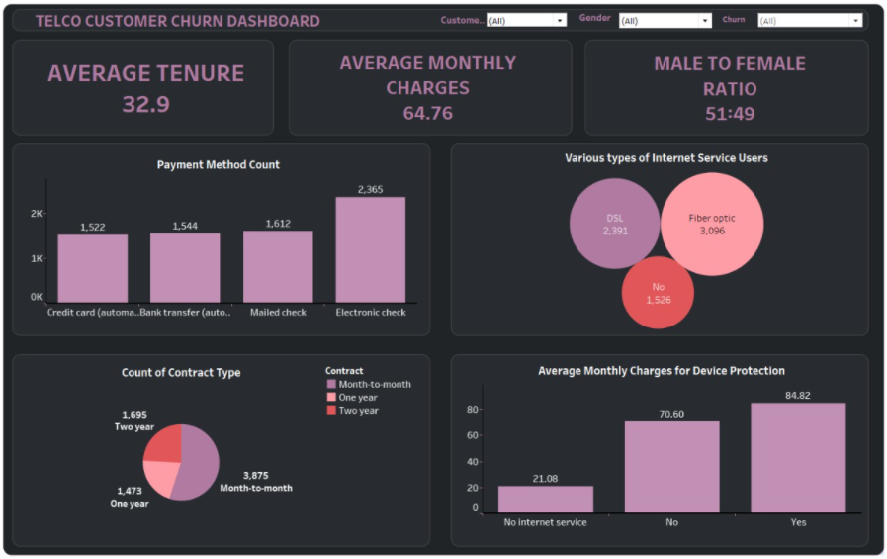
DATA STORYTELLING : DASHBOARD
DEPT. 4
TABLEAU LINK: Telco Customer Churn Dashboard - Nikhil Sanjay Thorat | Tableau Public

Slide 22
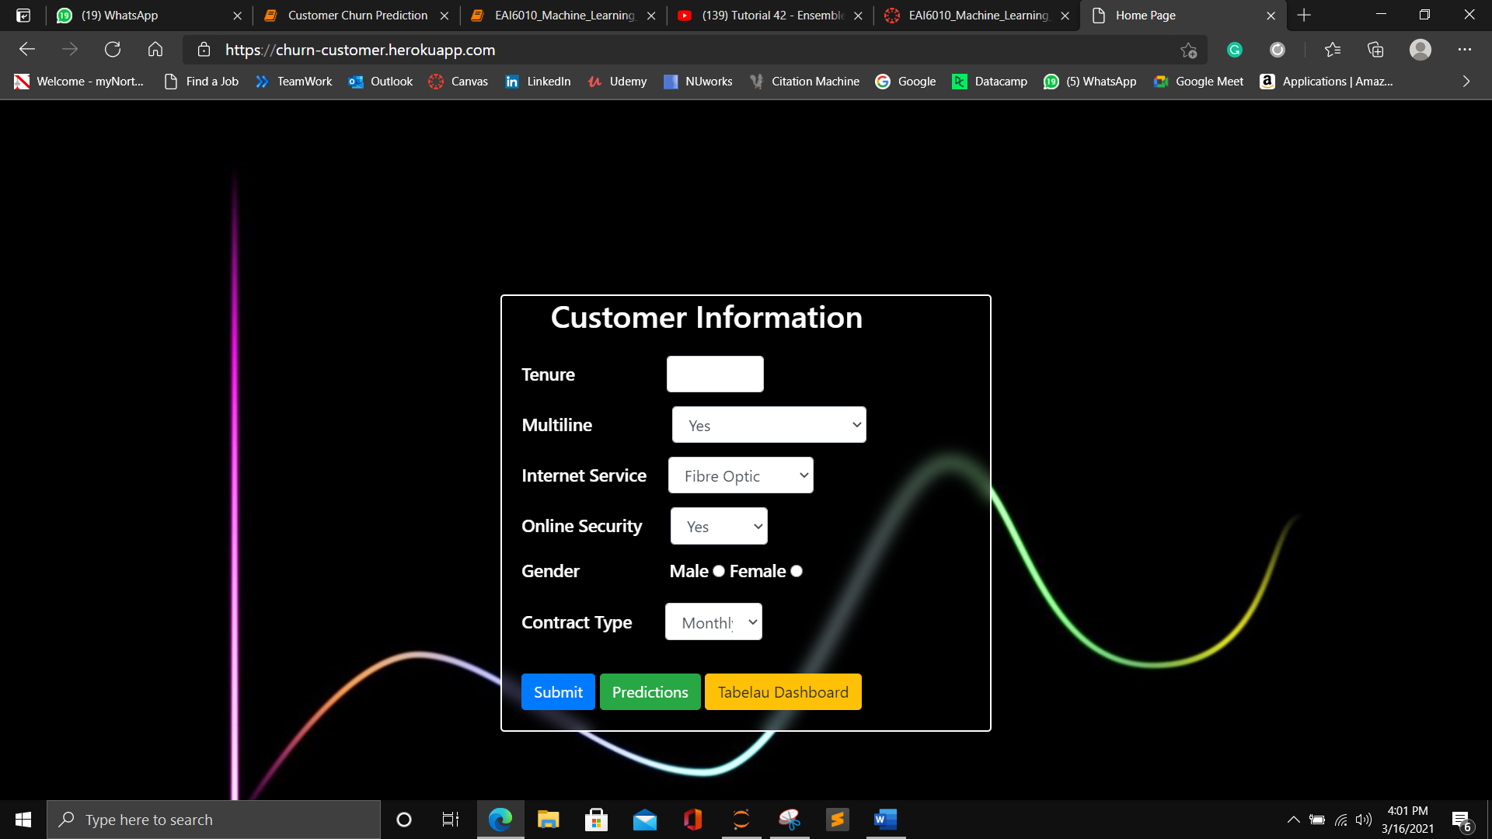
MODEL IN PRODUCTION
DEPT. 4
Webapp Link: Home Page (churn-customer.herokuapp.com)

Slide 23
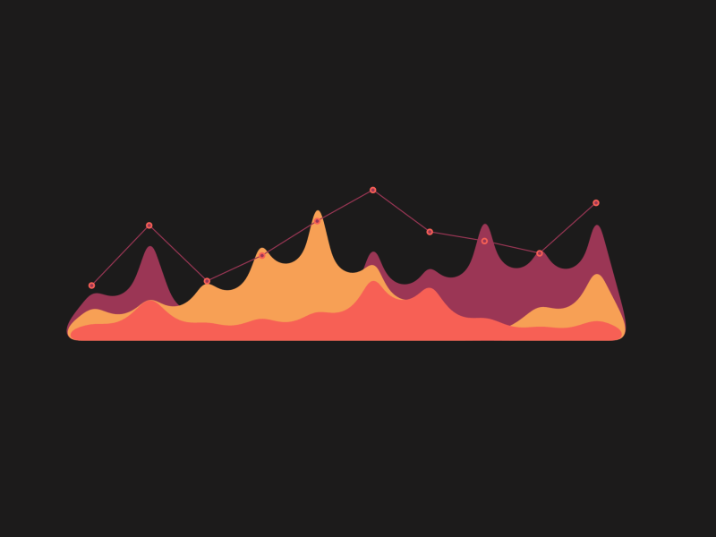
CONCLUSION
After trying various methods on the dataset to increase accuracy the maximum accuracy obtained was around 81% which was using Logistic regression.
Whereas other models also gave a similar accuracy around 80%.
Therefore we can conclude that we can use above mentioned models for classification of the customer churn prediction.

Slide 24
REFERENCES
Dataset : https://www.kaggle.com/itsmesunil/bank-loan-modelling
[1] R. Parmar, “Demystifying Optimizations for machine learning,” Medium, 05-Sep-2018. [Online]. Available: https://towardsdatascience.com/demystifying-optimizations-for-machine-learning-c6c6405d3eea. [Accessed: 16-Nov-2020]
[2] https://northeastern.instructure.com/courses/33355/files/5418529?module_item_id=4325658
[3] Dansbecker, “Using Categorical Data with One Hot Encoding,” 22-Jan-2018. [Online]. Available: https://www.kaggle.com/dansbecker/using-categorical-data-with-one-hot-encoding. [Accessed: 16-Nov-2020]
B. Ravichandran, “Visualize Geographical Data Using Maps in Dashboards,” 05-Oct-2020. [Online]. Available: https://www.boldbi.com/blog/visualize-geographical-data-using-map-dashboard. [Accessed: 22-Nov-2020]

Slide 25
THANK YOU!

